Slide 1
Data Mining Academic Emails to Model Employee Behaviors and Analyze Organizational Structure
Kayla Straub
Master’s Defense

Slide 2
Outline
Problem statement and contributions
Email dataset
Feature extraction
Algorithm design
Performance analysis
Future work and conclusions

Slide 3
Problem Overview
Email is everywhere!
Difficult to research email because of inherent privacy concerns
Lack of modern email datasets with accurate job title labels
What information about an organization is embedded in the organizational email communication?
Organic vs. official organizational charts
What information about an organization can be extracted from emails?
Notes:
Organic: under/over performing, social relationships, project work

Slide 4




Applications
Overall methods can be applied to any communication system
Cell phone, website links, social media, network connections
This particular type of analysis could benefit:
In Dec. 2015, GE completed downsize and merger of subsidiary General Electric Capital Corporation
On Jan. 1 2016, Northrop Grumman combined two of its four business sectors, Electronic Systems and Information Systems
In late 2016, the merger of two major chemical companies: DuPont and Dow will be finalized before splitting into three new companies

Slide 5
Contributions
Present a new email dataset based on academic emails of the center
Job title classification results that outperform previous work
A method to automatically generate organic hierarchy from analyzing emails
Paper submitted to IJCAI 2016
Shown that using machine learning on emails can reveal information about an organization

Slide 6
Email Dataset

Slide 7
Enron Dataset
Benchmark dataset for email analysis
Released in 2004
Used for research into spam classification, email categorization, and recipient prediction
Issues with the dataset
99.99% overlap between emails sent as “CC” and those sent as “BCC”
Some emails addresses, folders, and names are misspelled
Inconsistent email address formats make mapping to employees difficult
Issues with job title labels
No labels for 29 employees
Clear mislabeling errors for at least 4 employees

Slide 8
Prior Work
Prior work in hierarchy analysis often uses the text of the emails with natural language processing to generate features, mainly on Enron
Historically, email analysis without text uses two types of features:
Traffic-based: statistical features based on single emails
Social-based: features calculated based on email interactions between people
Success in determining community structures has been found using the two types separately
Namata et al. 2006 used traffic-based features to predict Enron job titles
Wilson and Banzhaf 2009 found Enron’s social networks from strictly social features
Rowe et al. 2005 used a combination of features to automatically construct the Enron social hierarchy
Notes:
Rowe did not have quantifiable results

Slide 9
Hume Email Data Collection
Worked with Virginia Tech’s Internal Review Board (IRB) to approve data collection procedures and privacy concerns
All subject and body text was hashed using MD5 algorithm
Data collection process was performed using automated scripts
No identifying information is revealed in analysis
All data stored on secure, password-protected Hume Center server
Hashing example:
b4dabd5884ecd175283065dc605c2172
Employment Opportunity at Doosan Fuel Cell America
Notes:
Privatized vs anonymized
Academic vs corporate emails

Slide 10
Email Parsing Process
Challenge: Email formats are inconsistent
Forwards are expressed as “Fw:” or “Fwd:” or “FW:”
Email address encoded with Unicode
Some emails have HTML- needed to identify, then parse
Process:
Write a python script to extract data
Test on personal emails to find inconsistent formatting issues
Ran script on mail server and saved all email metadata into MySQL database

Slide 11
Collected Data From Each Email
Destination and source email address
Email time stamp
Subject prefix (e.g., Re:, Fwd:)
Hash of subject after removing prefix
Hash of body text
Length of subject in characters
Length of body text in characters
Number of attachments
Indicator if email was digitally signed
Indicator if email was encrypted

Slide 12
Dataset Description and Statistics
37 volunteers in the study
Plus 32 additional employees from the data
585,096 emails over 3 years
6 job categories:
Director
Graduate Student
Operations
Outreach
Project Management (PM)
Research
Notes:
Mention that deleted emails are deleted from the server and not collected

Slide 13
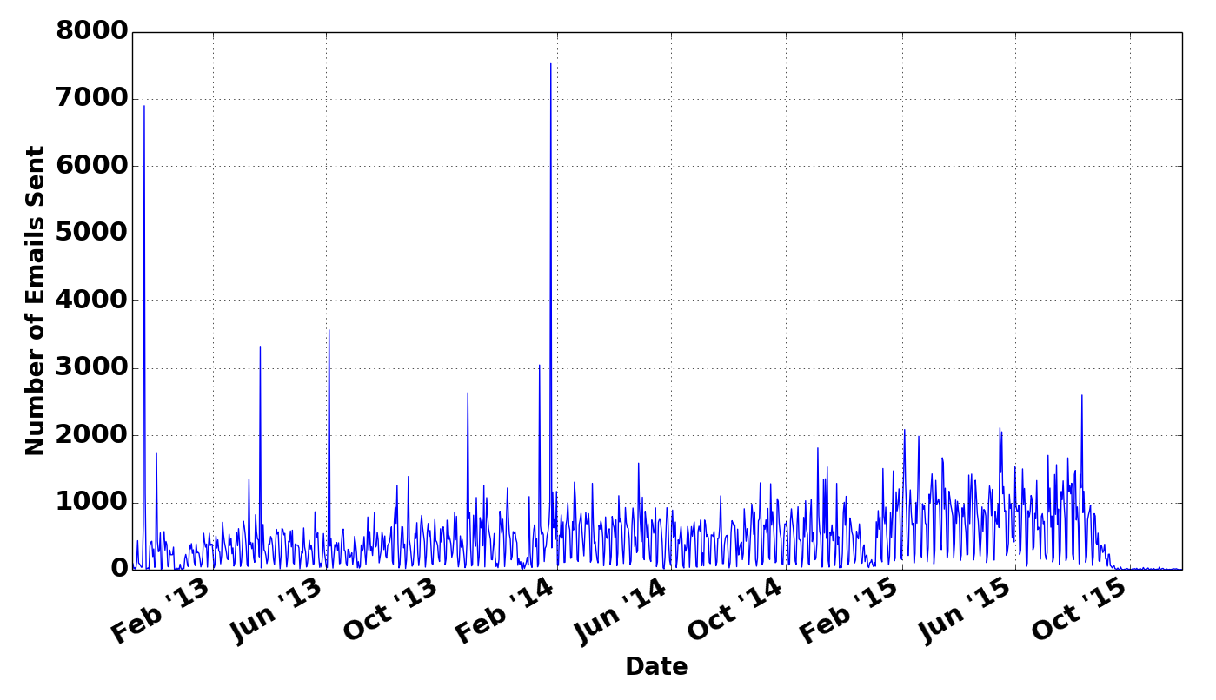
Hume Email Visualization
Notes:
Point out Christmas dips
Spikes most likely represent porting over from other servers

Slide 14
Hume Center vs. Enron Dataset Comparison
Hume Center dataset:
More modern
More distinct emails
Longer time period
Academic emails
Enron dataset:
More employees
More distinct email addresses
Corporate emails
 | Hume Center | Enron
Time | 11/2012-11/2015 | 1/2000-9/2002
Distinct Email Addresses | 32,118 | 75,406
Participants | 37 | 158
Distinct Emails | 585,096 | 252,759

Slide 15
Feature Extraction

Slide 16
Features
Features quantify information extracted from the email metadata
Two categories:
Traffic-based – 84 features
Social-based – 30 features
Total features: 114
Calculated using bash, MySQL, and python scripts
Used as input to the machine learning algorithm
Notes:
Traffic-based: Based on emails alone, usually one email at a time
Social-based: Looks at the interactions between people

Slide 17
Traffic-Based Features
Generated directly from the collected metadata
Example raw features:
Unique subjects received
Number of signed emails received
Number of emails received as carbon copies
Average number of emails received per day
Number of emails sent within VT
Number of emails sent within Hume
Number of emails sent after normal business hours
Also converted raw features as percentages

Slide 18
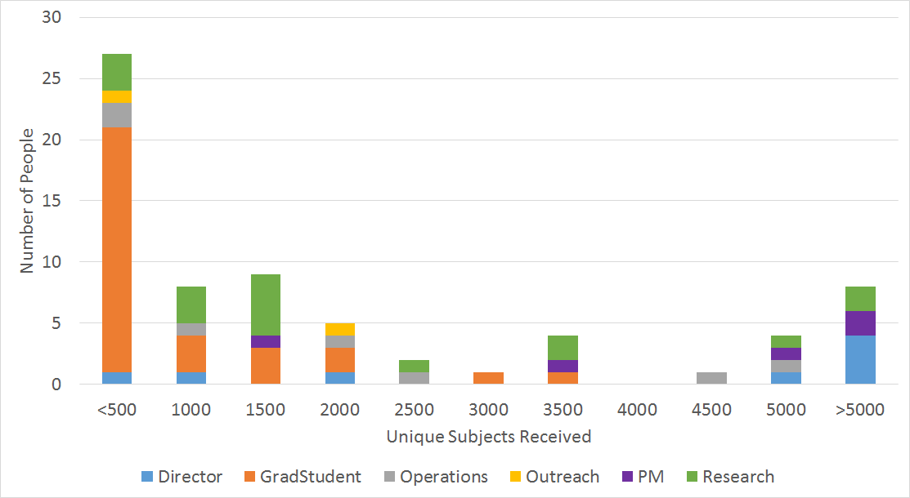
Example Traffic-based Feature

Slide 19
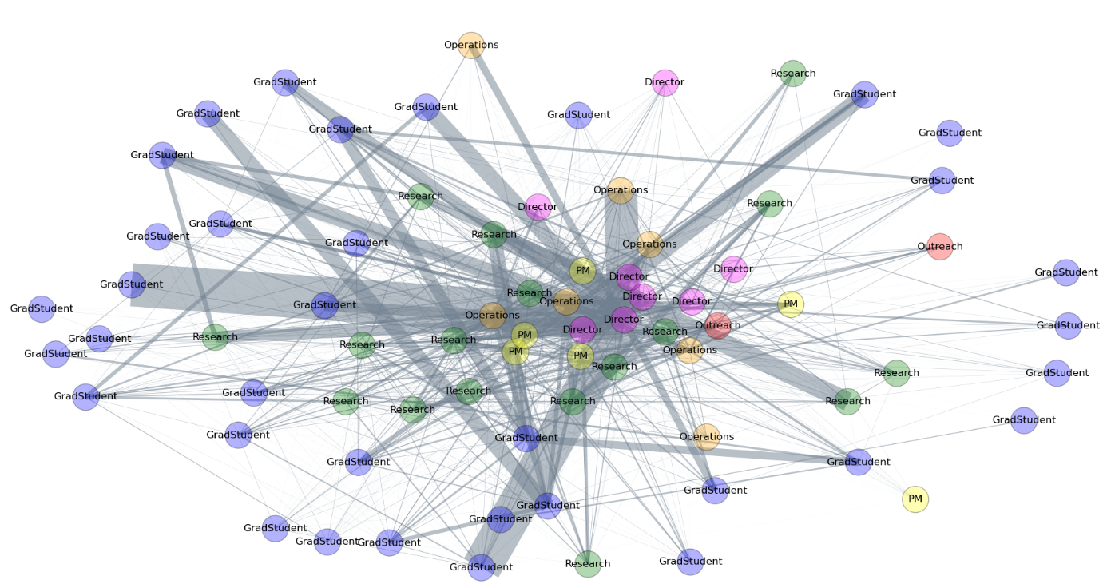
Social Graph
Nodes represent people
Edges are directed and represent emails exchanged between people
Two different graphs used
Full graph draws edge between people who exchanged at least one email
2532 edges, 86 nodes
Partial graph draws edge between people who exchanged at least 10 emails
1319 edges, 82 nodes
Notes:
Physics-based simulation
Fruchterman-Reingold force-directed algorithm

Slide 20
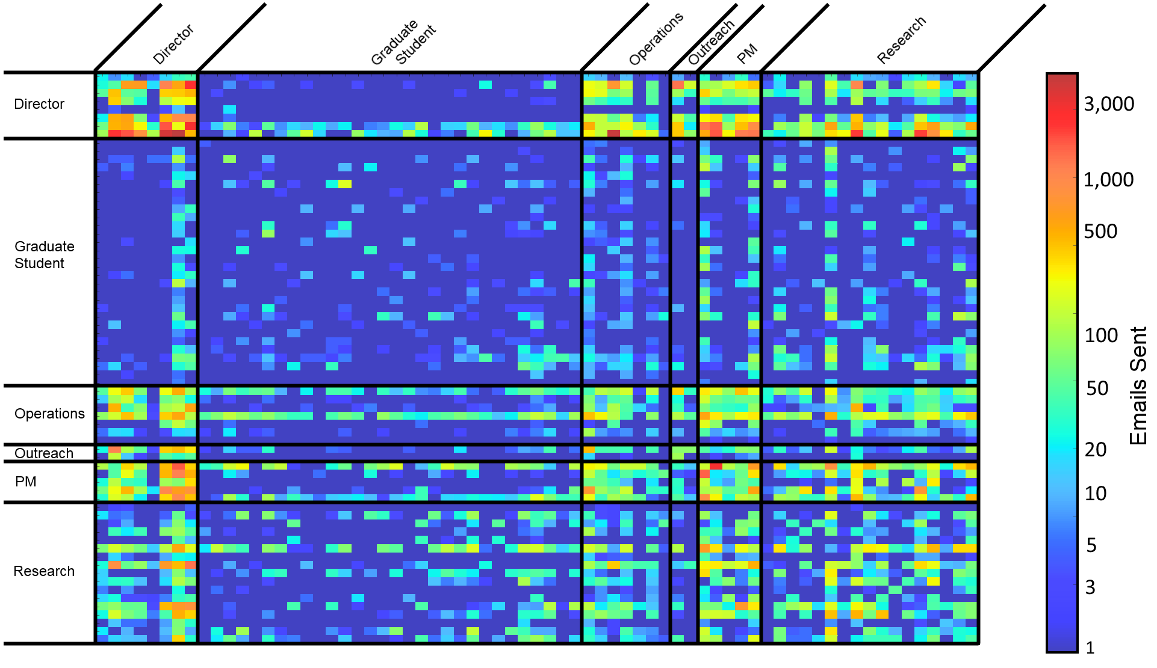
Alternative Social View - Adjacency Matrix

Slide 21
Social-Based Features
Degree measures
Degree of a node
Average neighbor degree
Cliques
Clustering Metrics
Search Engine Algorithms
Centrality Measures
All features calculated for both the full and partial graph
Notes:
Closeness centrality is the normalized inverse of the sum of shortest path distances from node I to all other nodes in the graph
Betweenness centrality is the percentage of all shortest paths in a graph the traverse node i

Slide 22
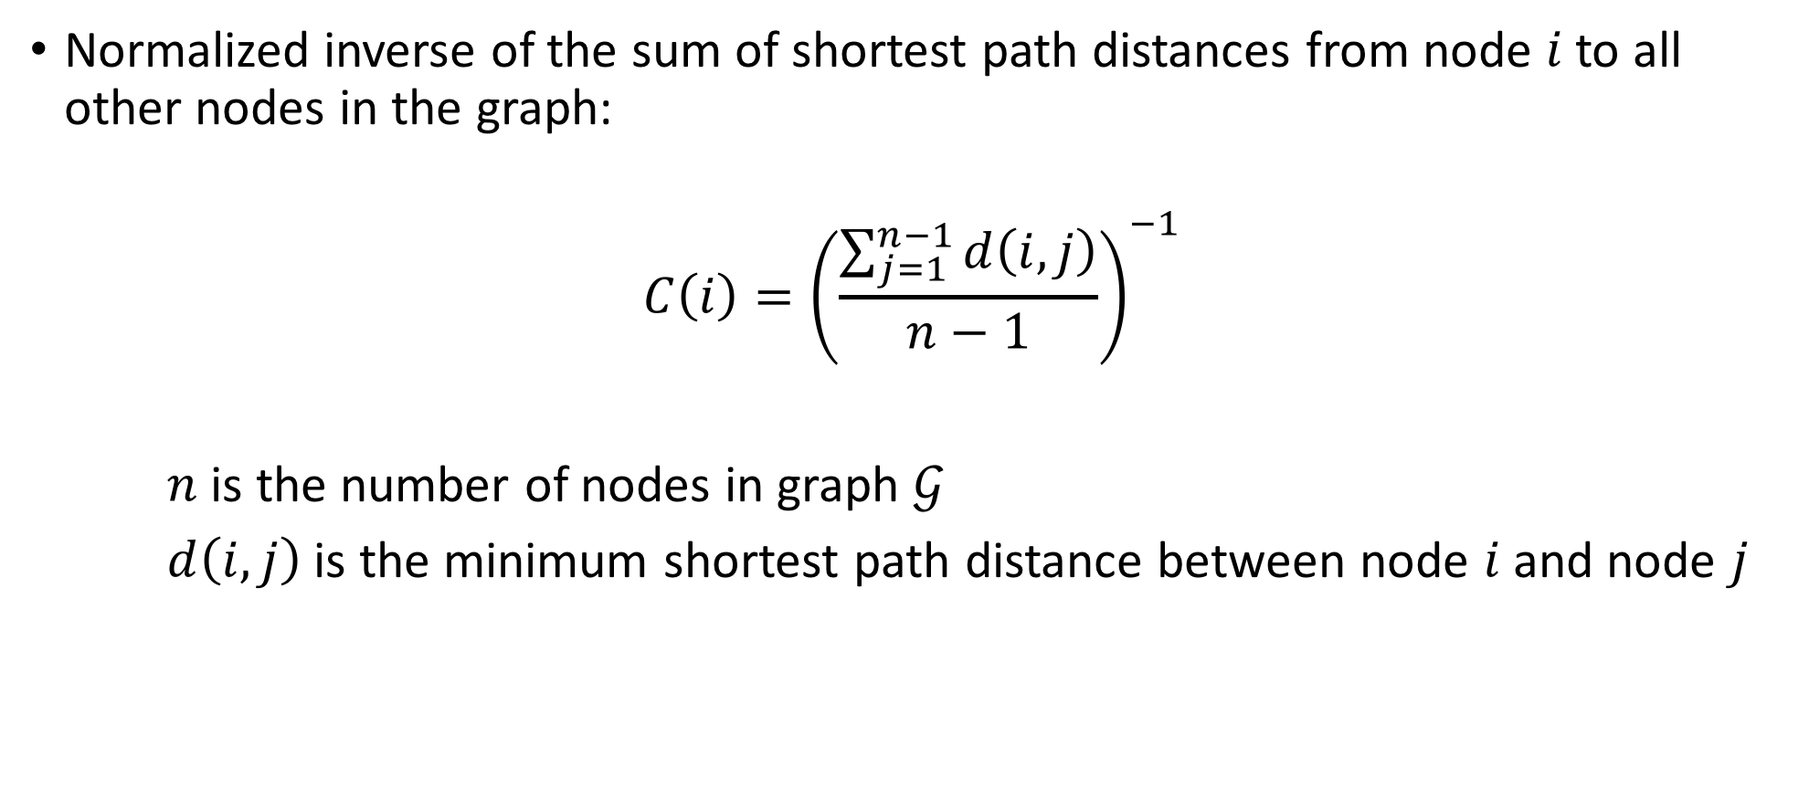
Closeness Centrality
Normalized inverse of the sum of shortest path distances from node $i$ to all other nodes in the graph:
$$C\left(i\right)={\left(\frac{\sum_{j=1}^{n−1}{d\left(i,j\right)}}{n−1}\right)}^{−1}$$
$n$ is the number of nodes in graph $𝒢$
$d\left(i,j\right)$ is the minimum shortest path distance between node $i$ and node $j$

Slide 23
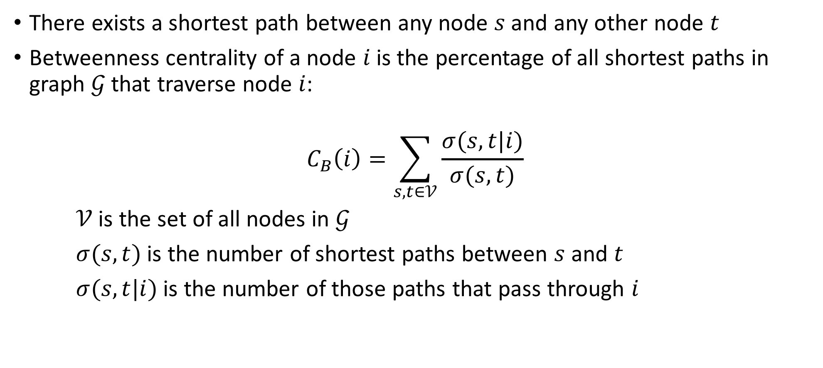
Betweenness Centrality
There exists a shortest path between any node $s$ and any other node $t$
Betweenness centrality of a node $i$ is the percentage of all shortest paths in graph $𝒢$ that traverse node $i$:
$$C_{B}\left(i\right)=\sum_{s,t∈𝒱}{\frac{σ(s,t|i)}{σ(s,t)}}$$
$𝒱$ is the set of all nodes in $𝒢$
$σ(s,t)$ is the number of shortest paths between $s$ and $t$
$σ(s,t|i)$ is the number of those paths that pass through $i$

Slide 24
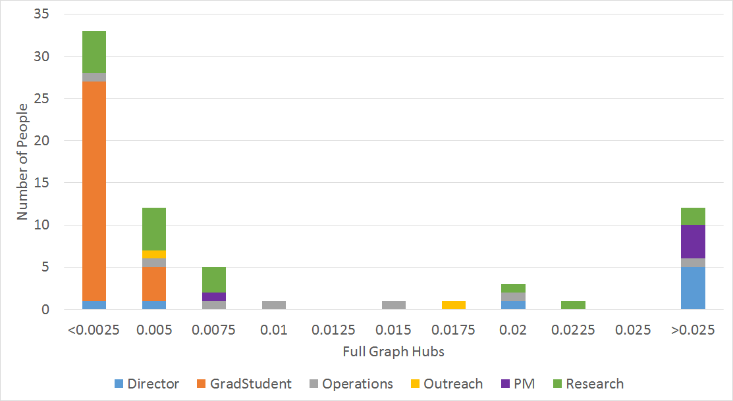
Example Social Feature

Slide 25
Algorithm Design

Slide 26
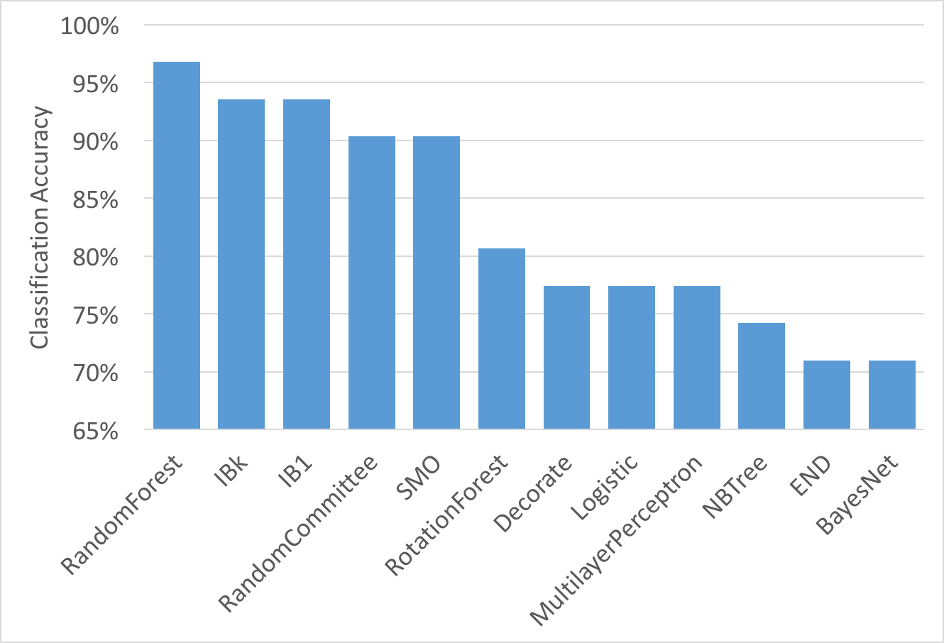
Algorithm Selection
Used limited number of employees:
29 participants
Removed people with less than 100 emails
Removed the two outreach employees
Randomly split emails into train and test sets
Using Weka, evaluated classification accuracy of several algorithms with default parameters
Notes:
This was an EARLY analysis
Random forest was what I expected to perform best: they’re robust and work well with lots of features
Also matches the Namata paper
IBk = k-NN
IB1 = Nearest neighbor
RandomCommittee = Average prediction of a committee of base classifiers – in this case the base classifier was random tree
SMO = Support vector machine using sequential minimal optimization, for multiclass it uses 1 vs 1 pairwise classification
RotationForest =

Slide 27
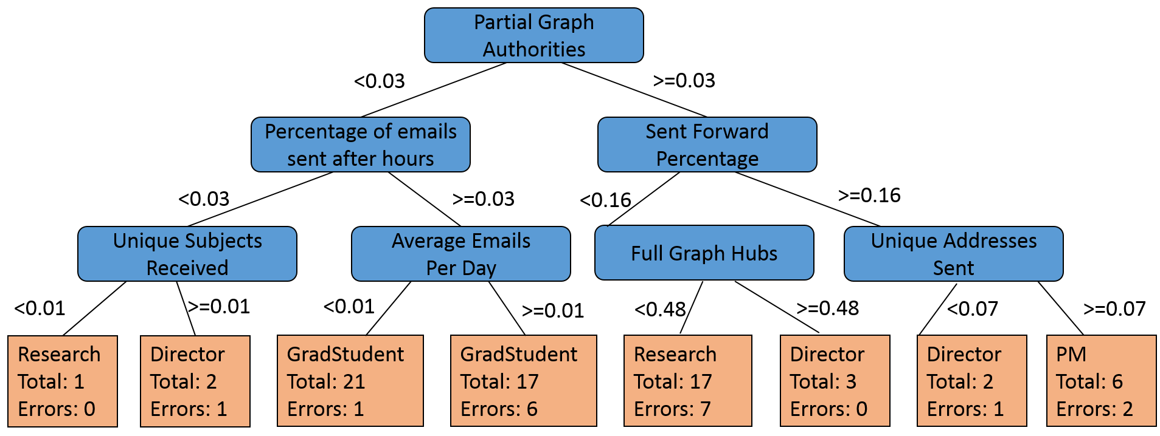
Random Trees
Used to learn a series of rules for classification
Learned using a greedy heuristic
Starting at the top, split on the best feature
Automatic feature selection
Tree-based classifiers are prone to over-fitting
Low bias, high variance

Slide 28
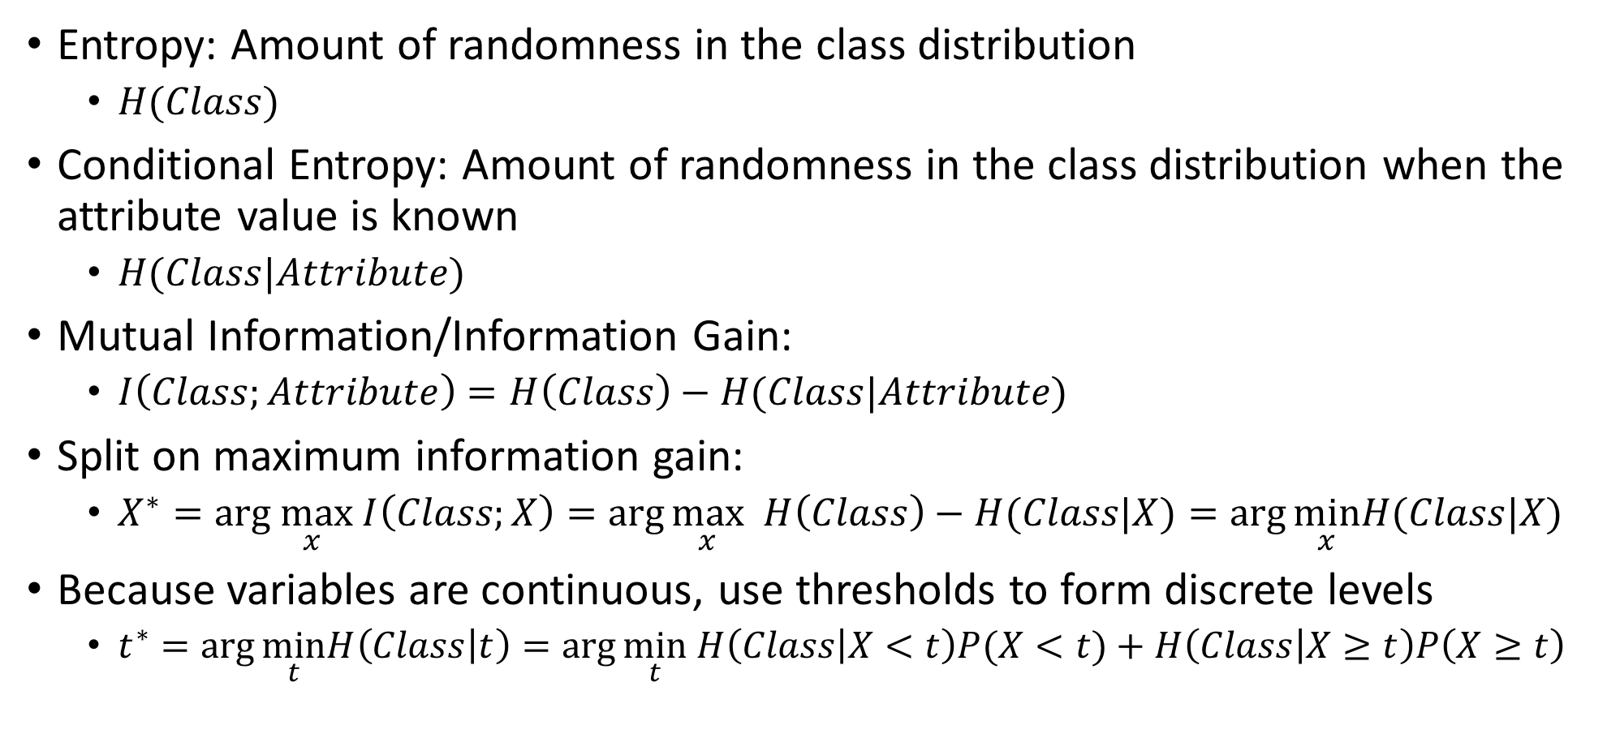
Determining the Best Split
Entropy: Amount of randomness in the class distribution
$H(Class)$
Conditional Entropy: Amount of randomness in the class distribution when the attribute value is known
$H(Class|Attribute)$
Mutual Information/Information Gain:
$I\left(Class;Attribute\right)=H\left(Class\right)−H(Class|Attribute)$
Split on maximum information gain:
$X^{∗}=arg\max_{x} I\left(Class;X\right)=\arg{\max_{x} H\left(Class\right)−H(Class|X)}=\arg{\min_{x}H(Class|X)}$
Because variables are continuous, use thresholds to form discrete levels
$t^{∗}=\arg{\min_{t}H\left(Class | t\right)=\arg{\min_{t} H\left(Class | X<t\right)P(X<t)}}+H\left(Class | X≥t\right)P\left(X≥t\right)$

Slide 29
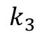
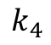
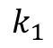
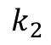
Random Forests
Random forests are an ensemble method that is robust to overfitting
Learn many deep random trees and take majority vote of prediction outputs
“Bagging”, or Bootstrap Averaging
Random elements introduced in each tree:
Only a subset of features used
Only a subset of training data used
Data
Random Subset
Random Subset
Random Subset
Random Subset
$$k_{1}$$
$$k_{2}$$
$$k_{3}$$
$$k_{4}$$
Voting
Final Prediction

Slide 30
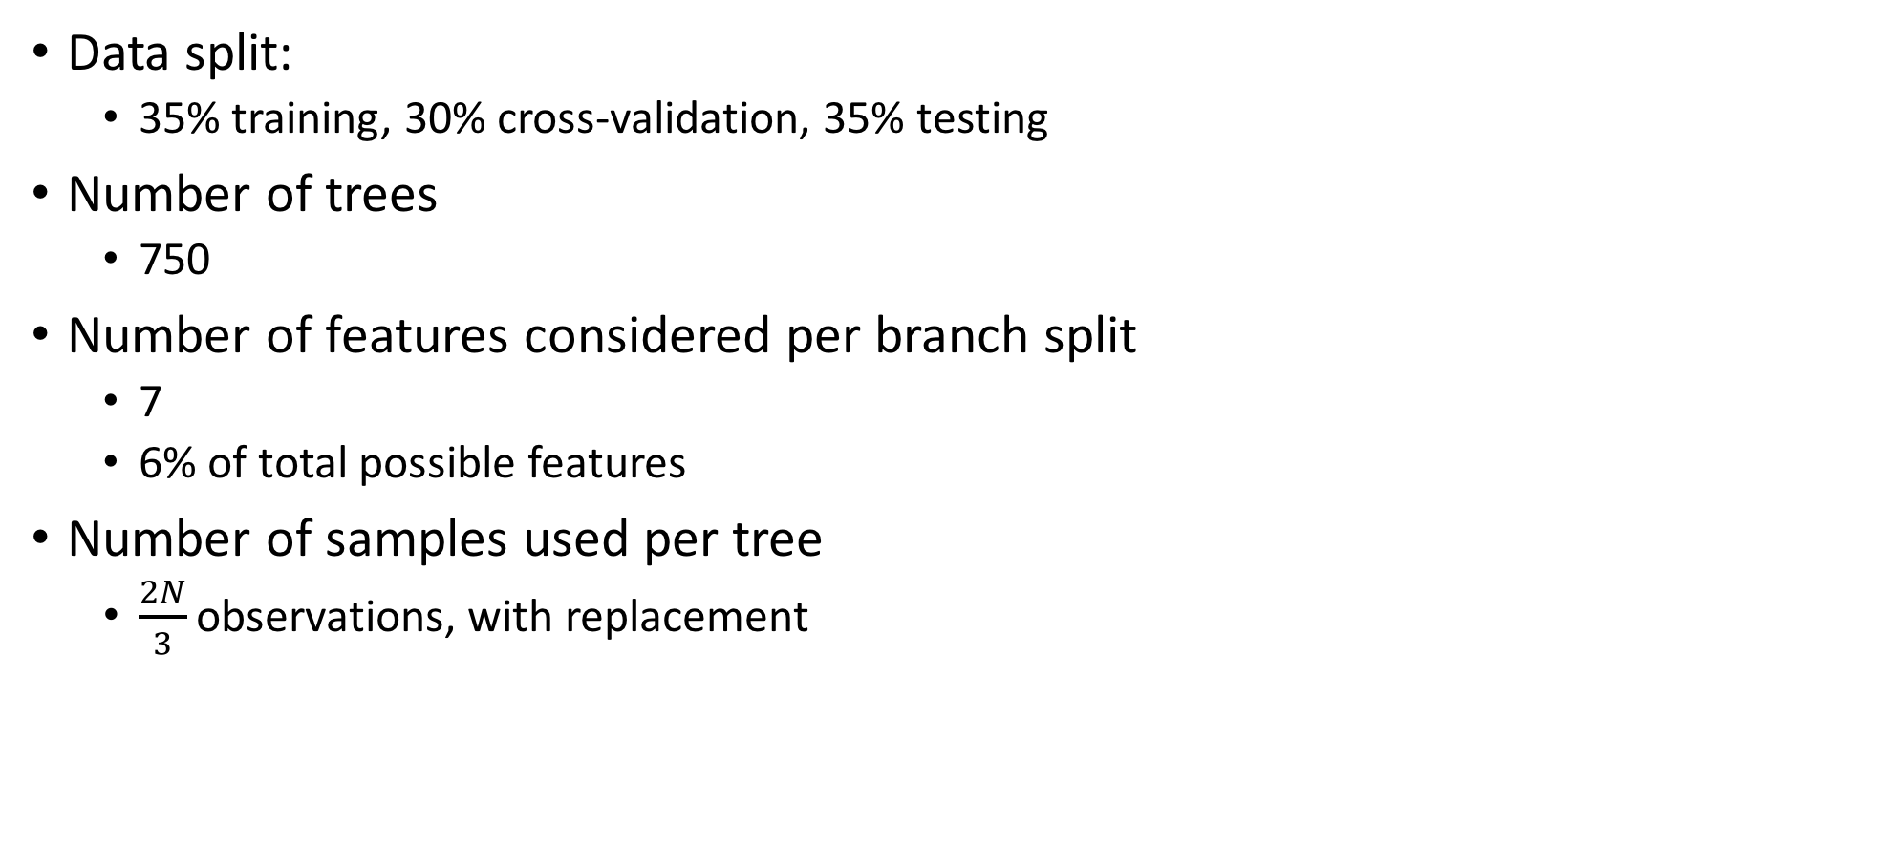
HyperParameters
Data split:
35% training, 30% cross-validation, 35% testing
Number of trees
750
Number of features considered per branch split
7
6% of total possible features
Number of samples used per tree
$\frac{2N}{3}$observations, with replacement

Slide 31
Feature Selection
New | Feature | Type | Information Gain
 | Unique subjects received | Traffic | 0.728
 | Total signed emails received | Traffic | 0.728
 | Hubs (partial graph) | Social | 0.589
 | Number of emails received as forwards | Traffic | 0.519
 | Current flow closeness centrality (partial graph) | Social | 0.512
 | Pagerank (partial graph) | Social | 0.512
 | Percentage of emails sent with unique addresses | Traffic | 0.51
 | Number of emails received as carbon copies | Traffic | 0.5
 | Pagerank (full graph) | Social | 0.492
 | Average number of emails received per day | Traffic | 0.489
 | Communicability betweenness centrality (partial graph) | Social | 0.486
 | Communicability centrality (partial graph) | Social | 0.486
Notes:
Features ranked by Info gain
15 features – still 90% classification accuracy

Slide 32
Performance Analysis

Slide 33
Classification Results
Training: random 35% of emails
Cross-validation: random 30% of emails
Testing: random 35% of emails
Using Random Forests and tuned hyperparameters
Assumptions:
Employees of the same title exhibit similar email behaviors
Behavior is consistent over time

Slide 34
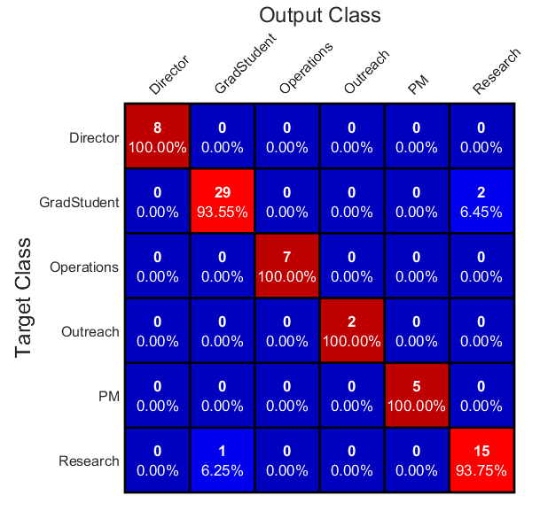
Classification Results
Overall very accurate: 95.7%
Confusion between graduate students and researchers
These errors are understandable
Some doctoral students have been working at the center for 3-5 years
Some research faculty are also graduate students

Slide 35
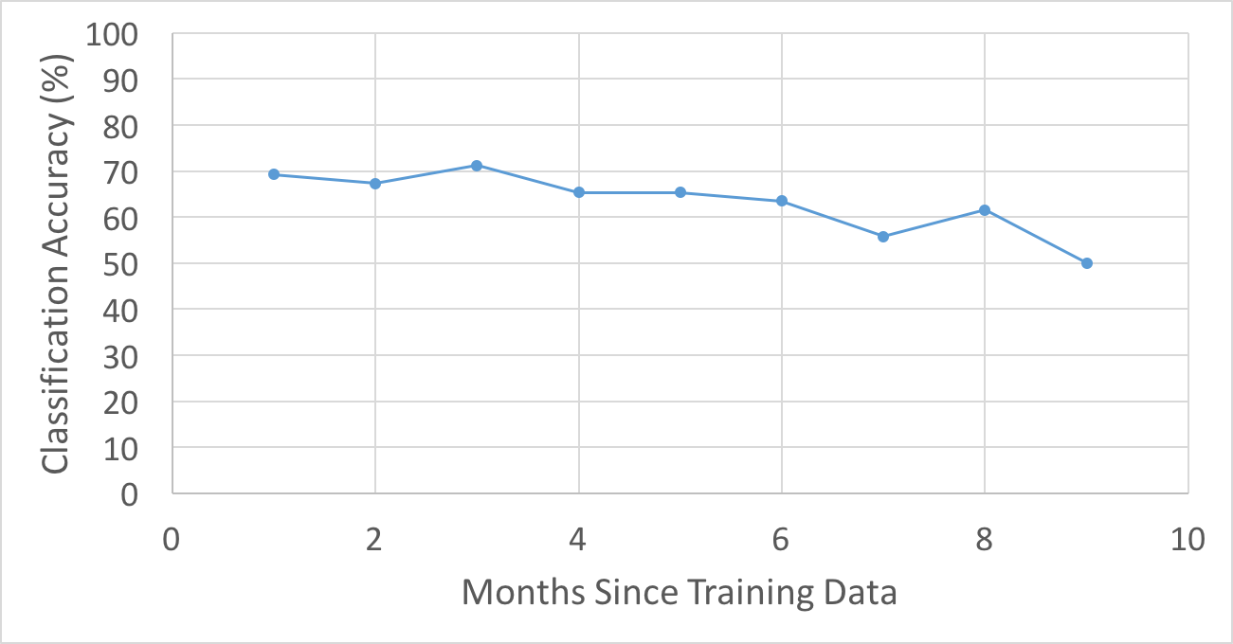
Behavior Over Time
Considered employees with at least 10 months of emails
Procedure:
Data split into 1-month segments
First month used as training
Months 2-10 used as test data
Confirms assumption that email behavior is constant in time

Slide 36
Leave-One-Out Cross-Validation
Concerned about bias from training and testing on same people
Procedure
Train on all but one sample
Test on that sample
Repeat for all samples
Relies more on assumption that employees of the same title exhibit similar email behaviors
Removed Outreach for this test because only contains two samples

Slide 37
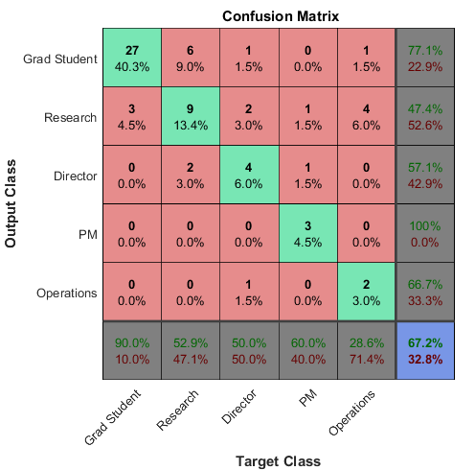
LOOCV Classification Results
Lower accuracy than previous result
67.2% overall
Due to low sample size
Graduate students very accurate
90.0%
In each category, there are more true positives than false positives from any other label

Slide 38
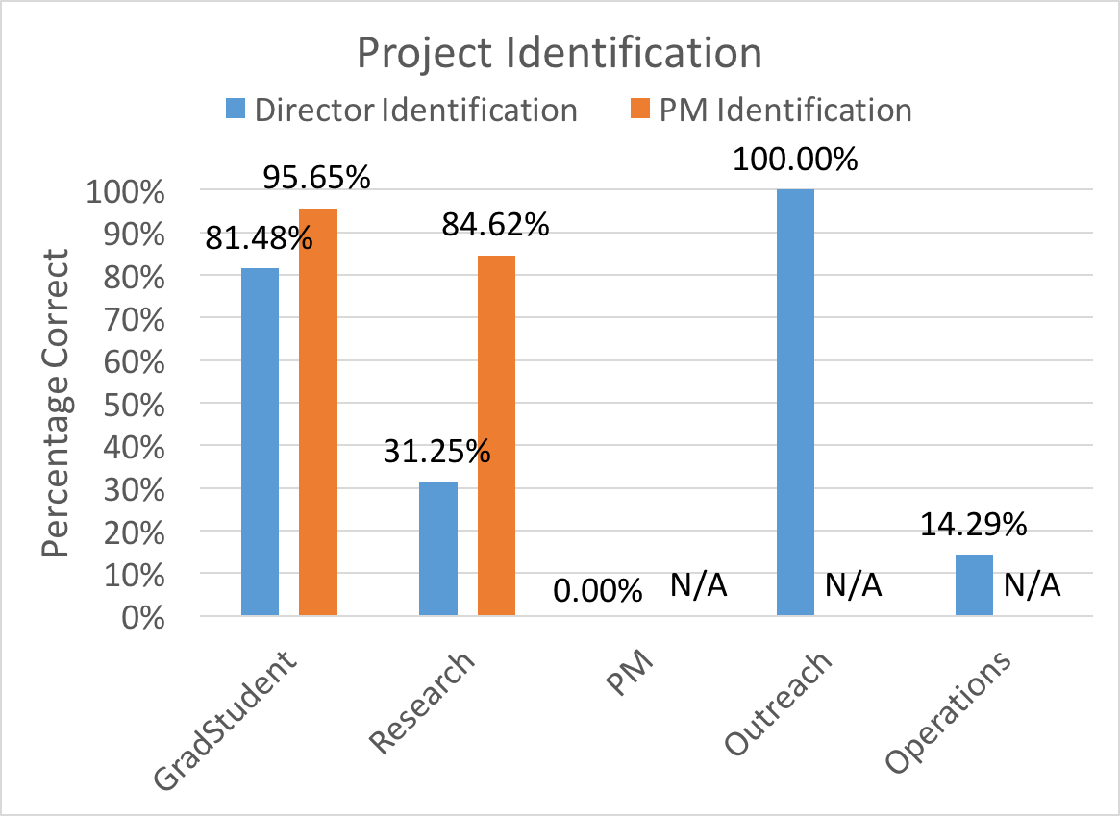
Hierarchy Analysis
Gathered ground-truth project labels
Director for all employees
PM for graduate students and researchers
Overall:
52.63% communicated most with assigned director
91.67% communicated most with assigned PM
Supervisor labels were unavailable for some past employees
Overall PM relationships are more consistent with official hierarchy than director relationships

Slide 39
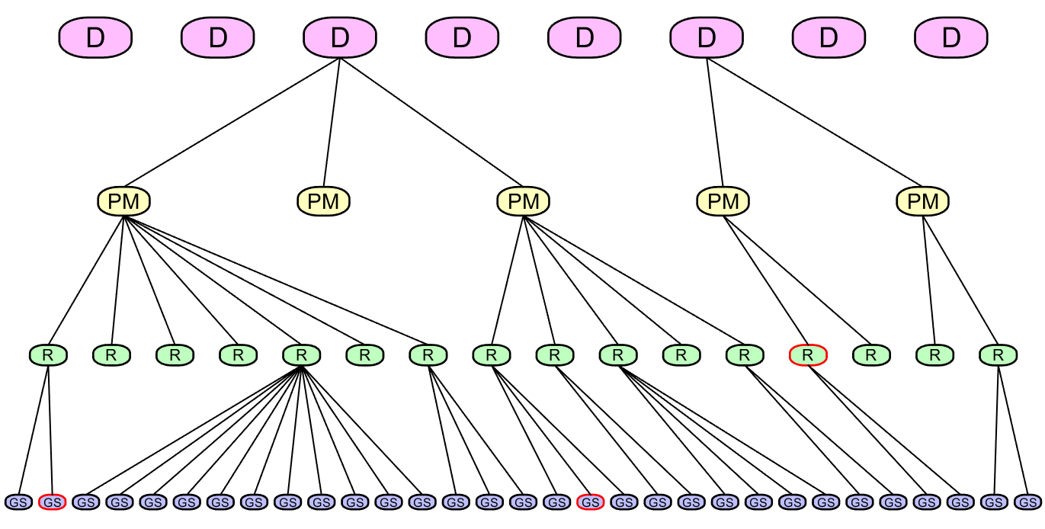
Algorithm-Generated Organic Org Chart
Notes:
Potential corporate espionage

Slide 40
Conclusions and Future Work

Slide 41
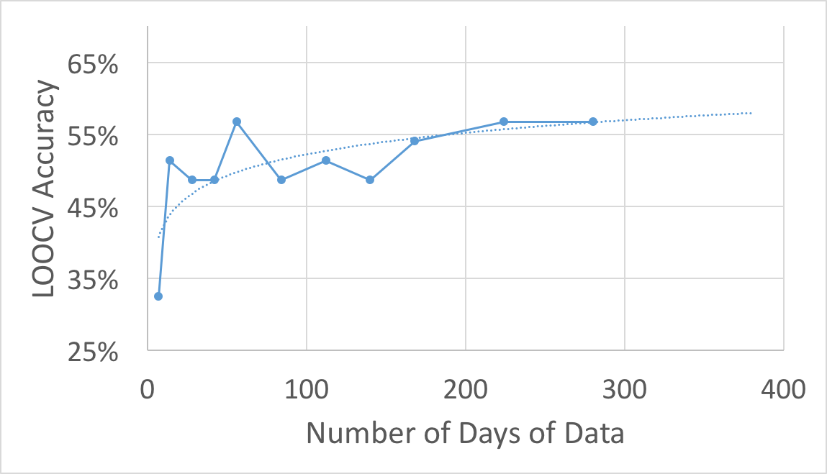
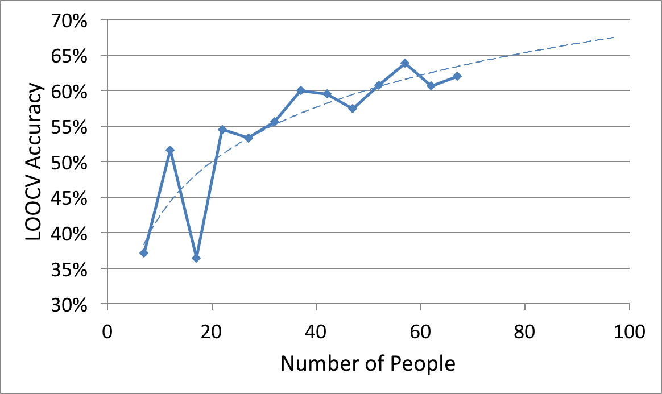
More Data would Improve

Slide 42
Future Work and Deep Learning Applications
Apply to larger datasets and/or different types of data
Cleaned Enron corpus
Clinton Email dataset
Twitter dataset
Potential Deep Learning Application
More sophisticated algorithms could be used
But need much more semi-supervised data
Deep Belief Networks
Unsupervised pre-training
Supervised back propagation

Slide 43
Conclusions
Created a brand new email dataset from raw emails
With accurate job title labels
Approximately the size of Enron, but with fewer people
Privacy precautions
This dataset is meant to be representative of data any company could collect without violating the privacy of their employees
Highly accurate classification results based on historical data
Showed that email behavior is constant with time
Small dataset lead to low LOOCV accuracy
An organic organization chart was produced that represented the email relationships of the center

Slide 44
Questions?

Slide 45
Thank You
Committee: Dr. McGwier, Dr. Beex, Dr. Buehrer, Dr. Huang
Dr. Ernst and Dr. Headley
Faculty, staff, and graduate students of the Hume Center

Slide 46
Backup

Slide 47
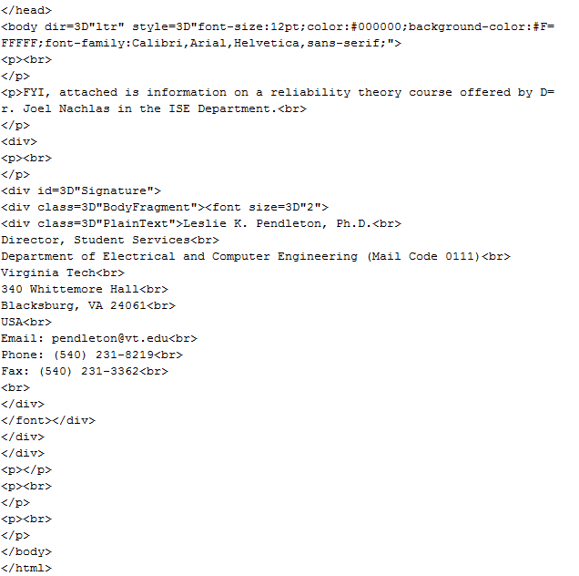
HTML Example

Slide 48
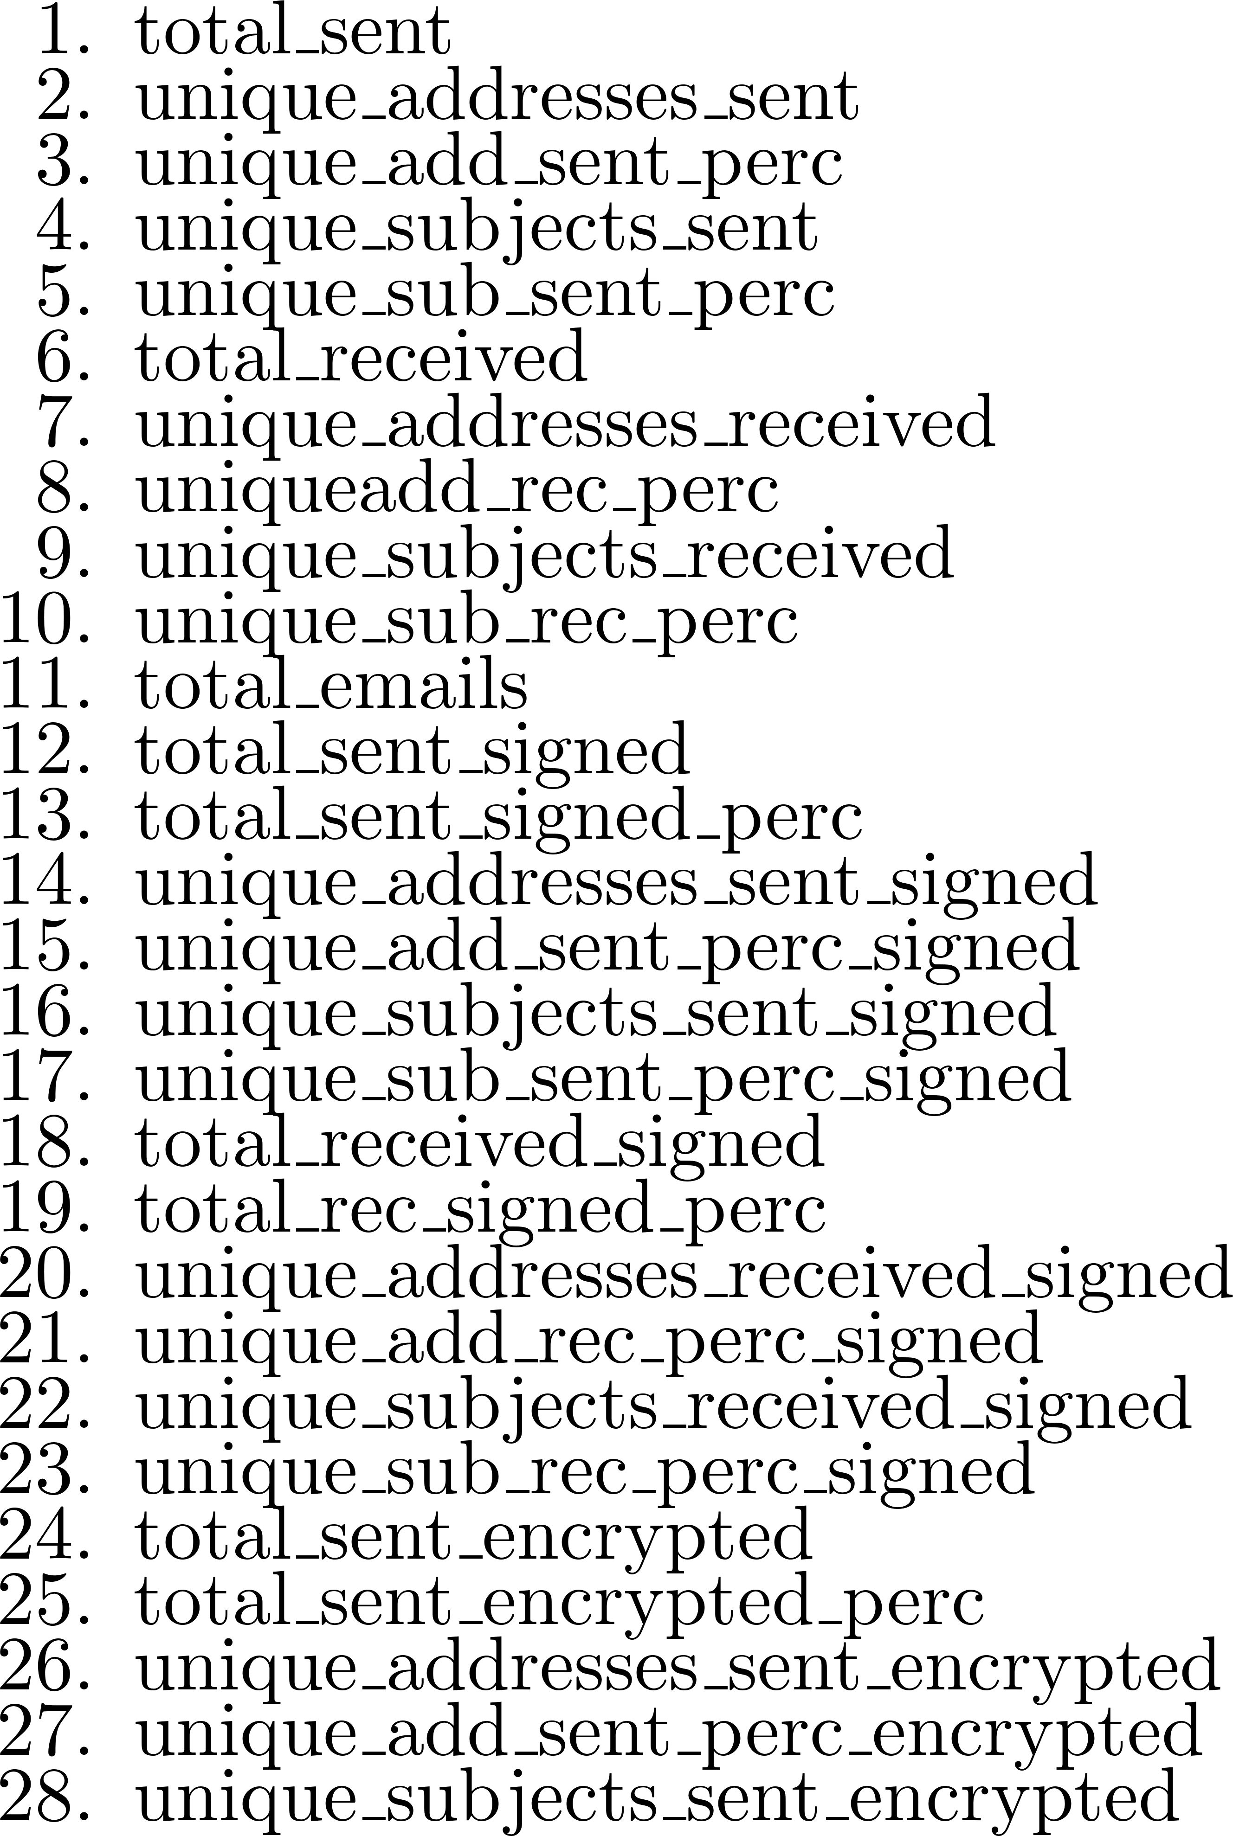
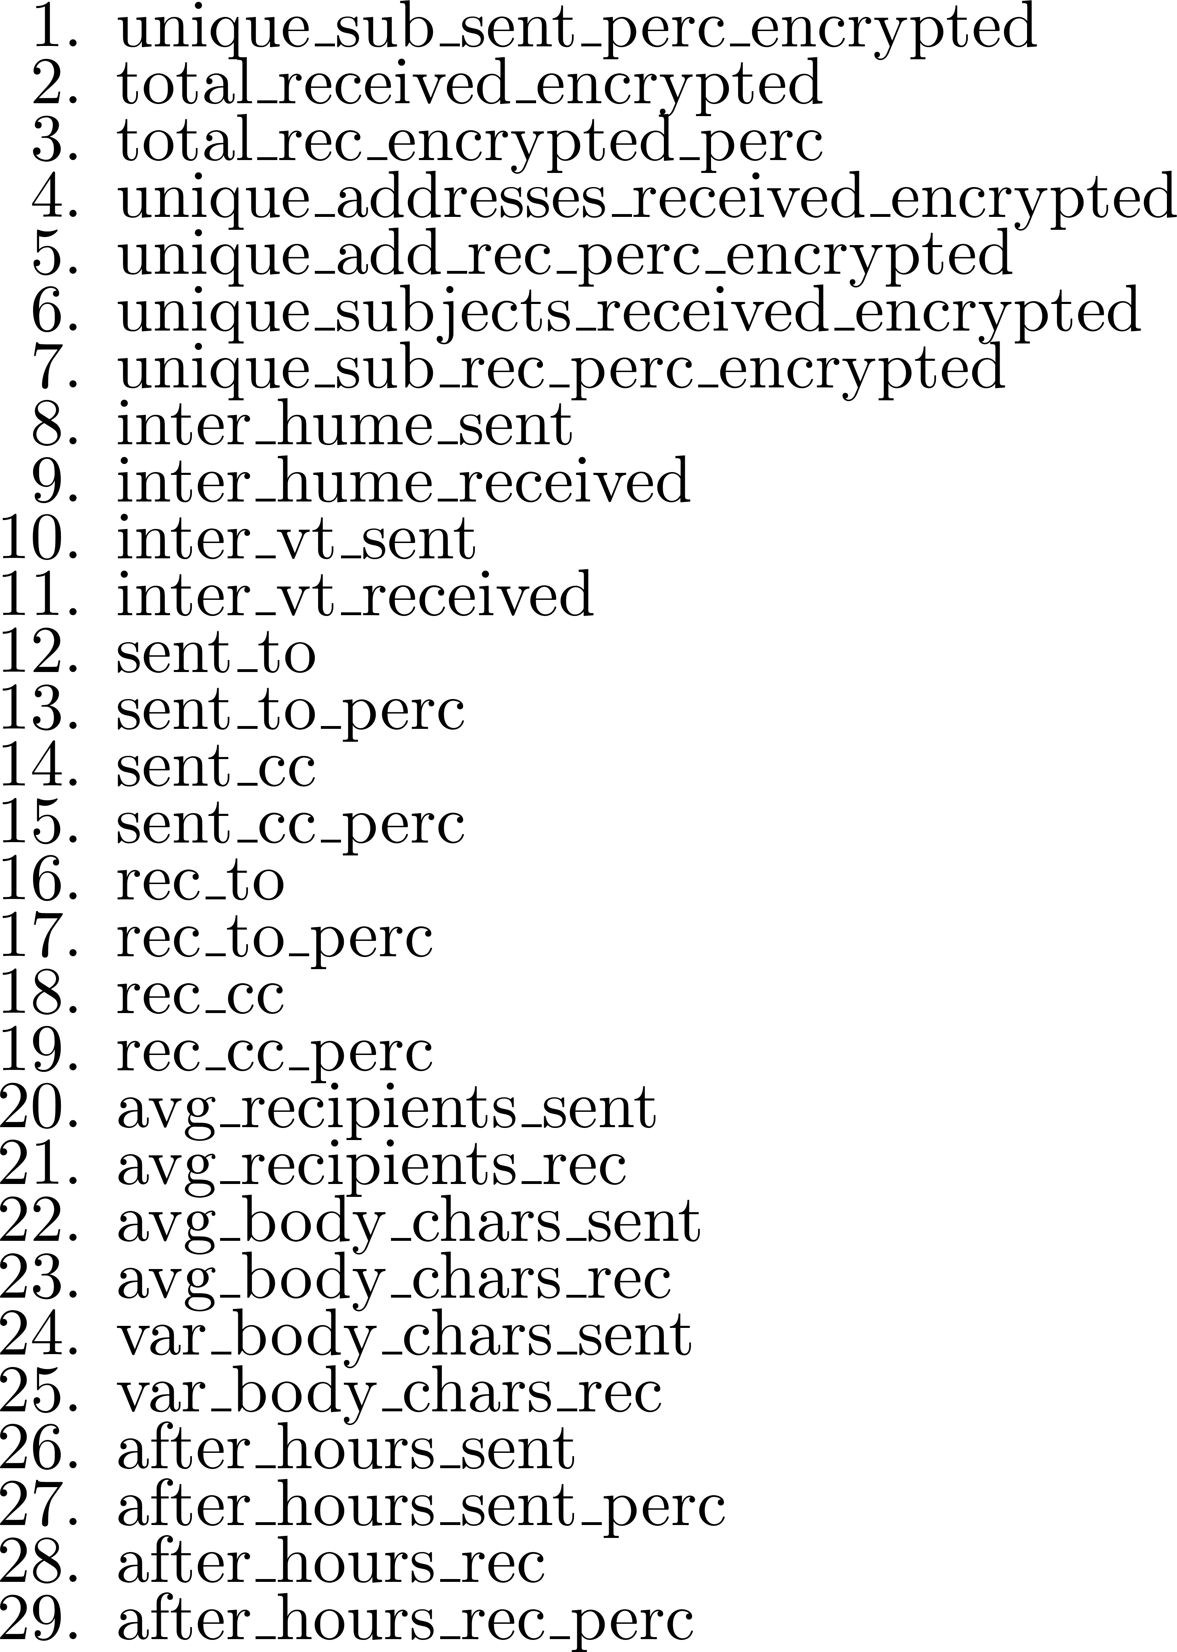
All Features

Slide 49
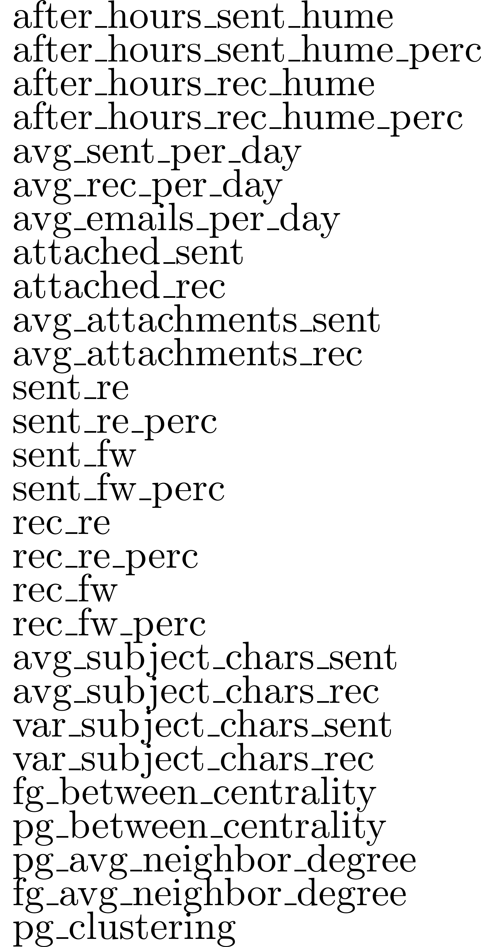
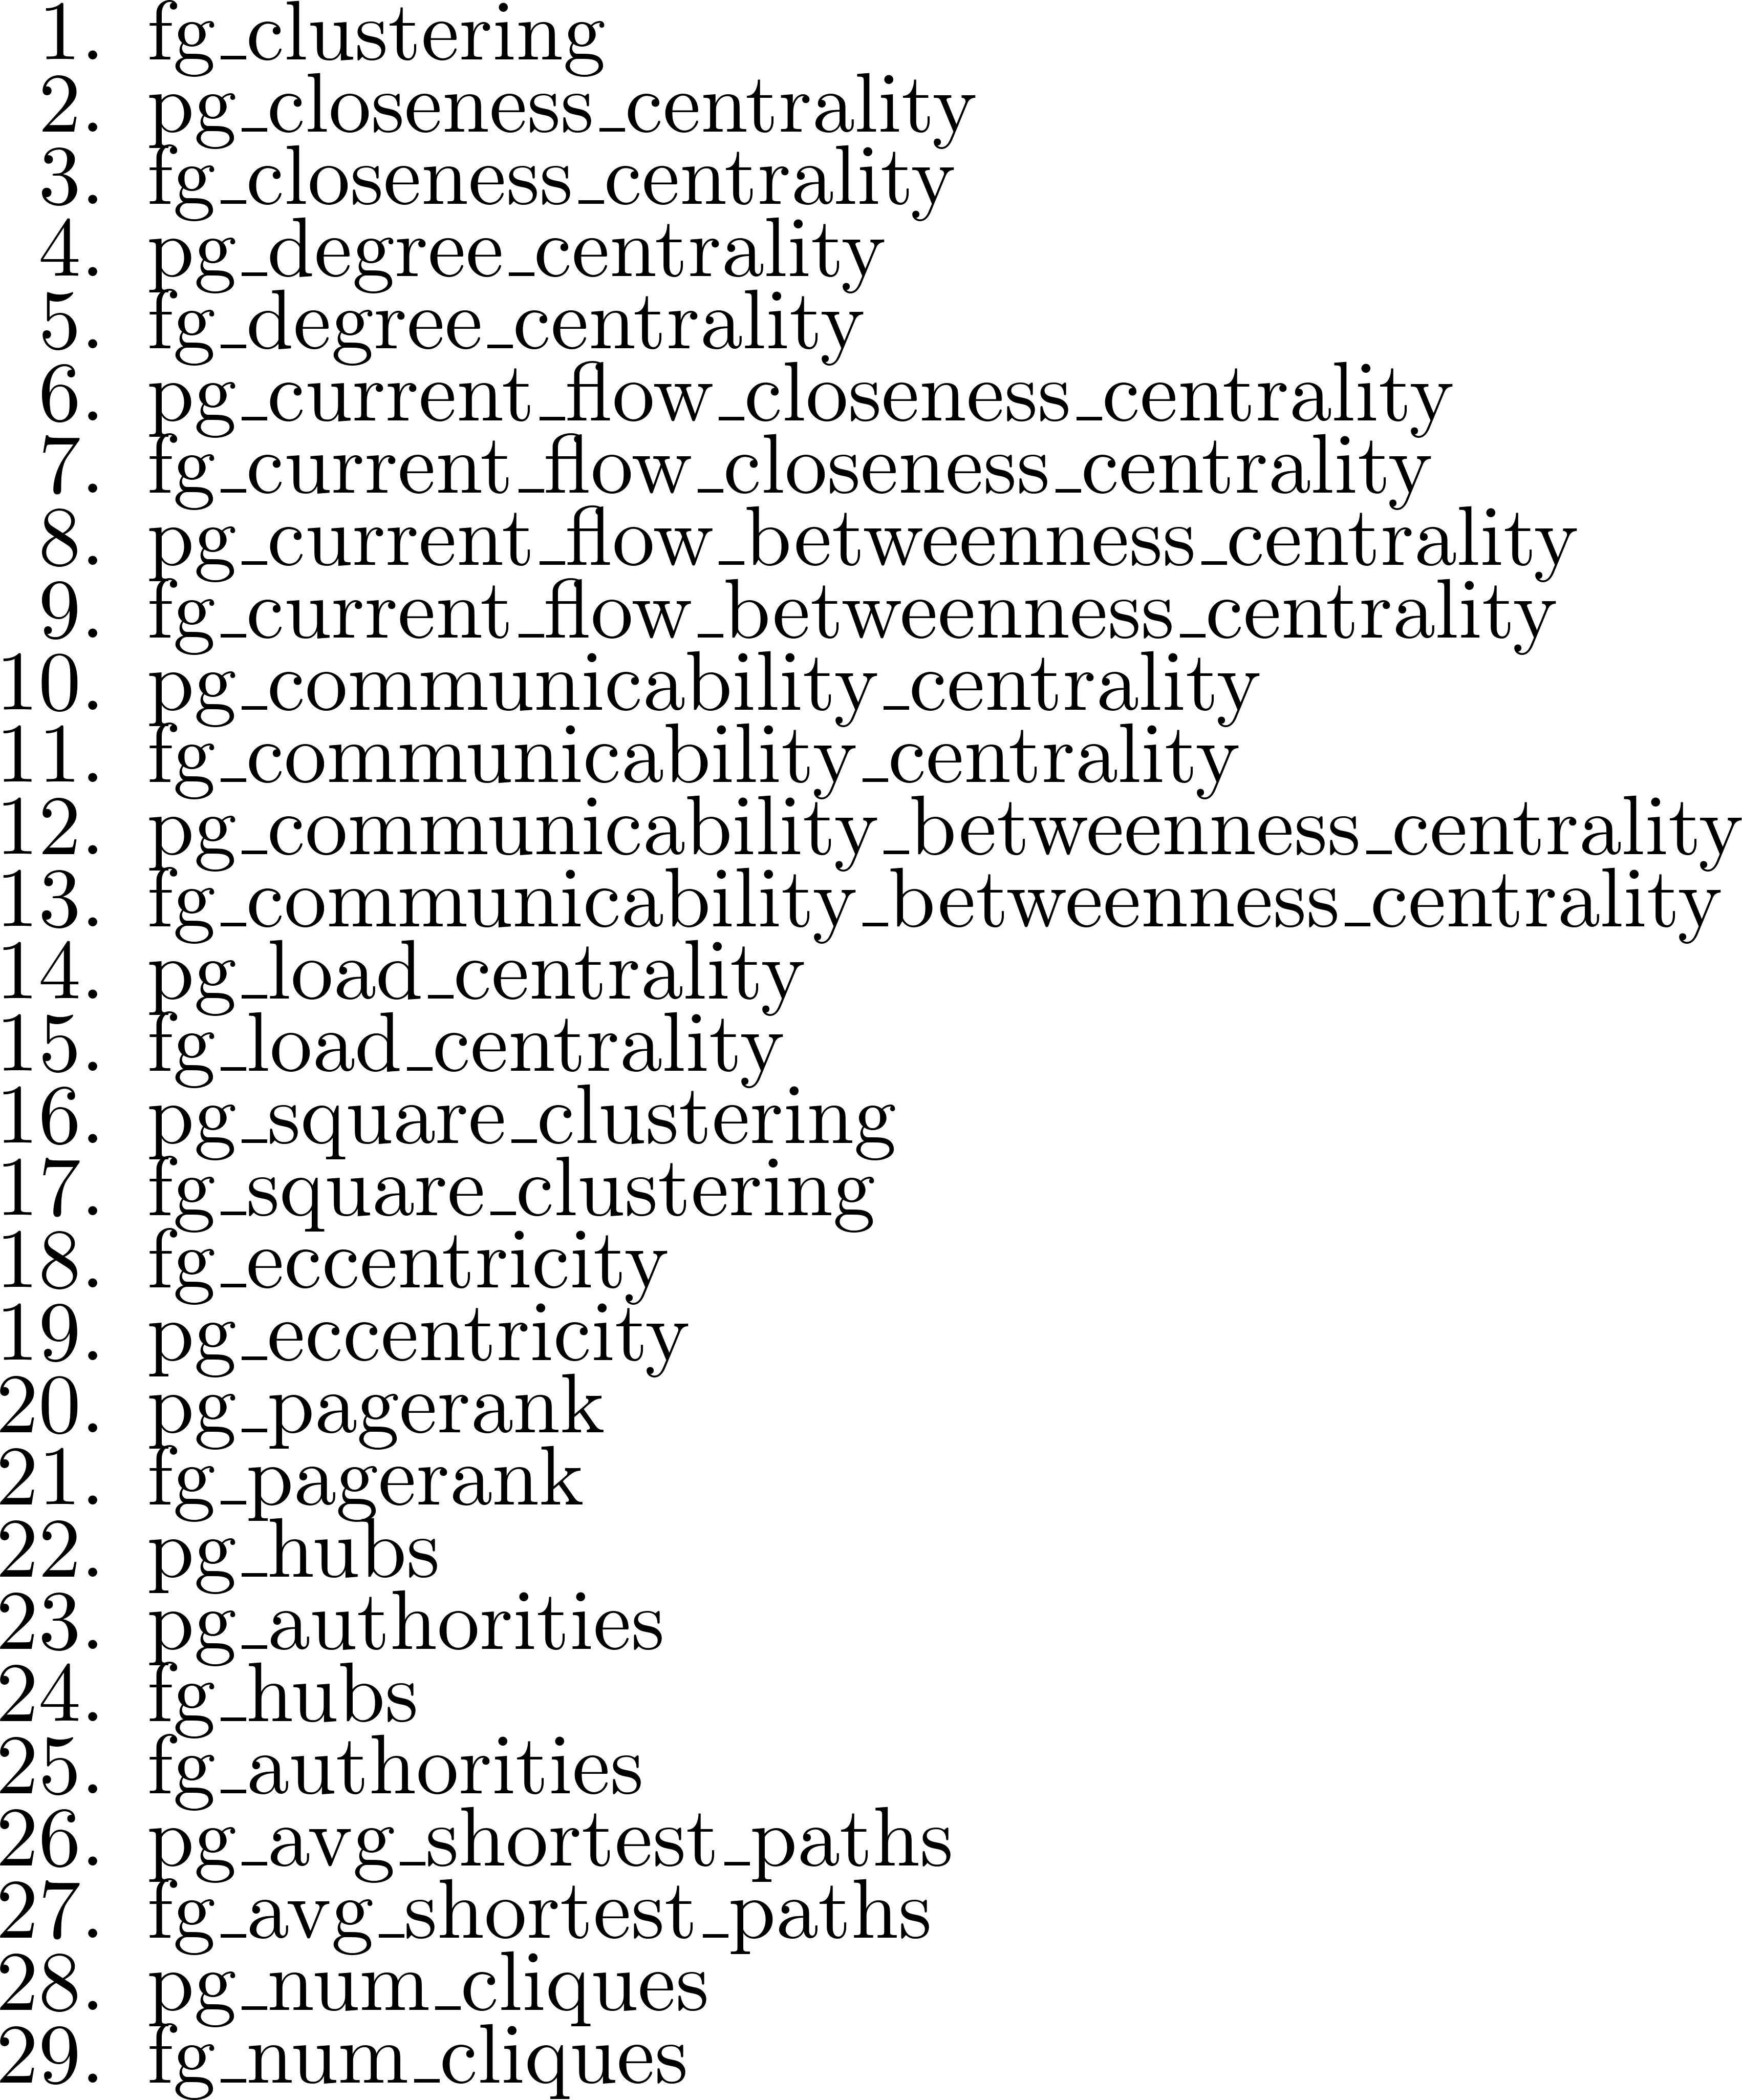
All Features

Slide 50
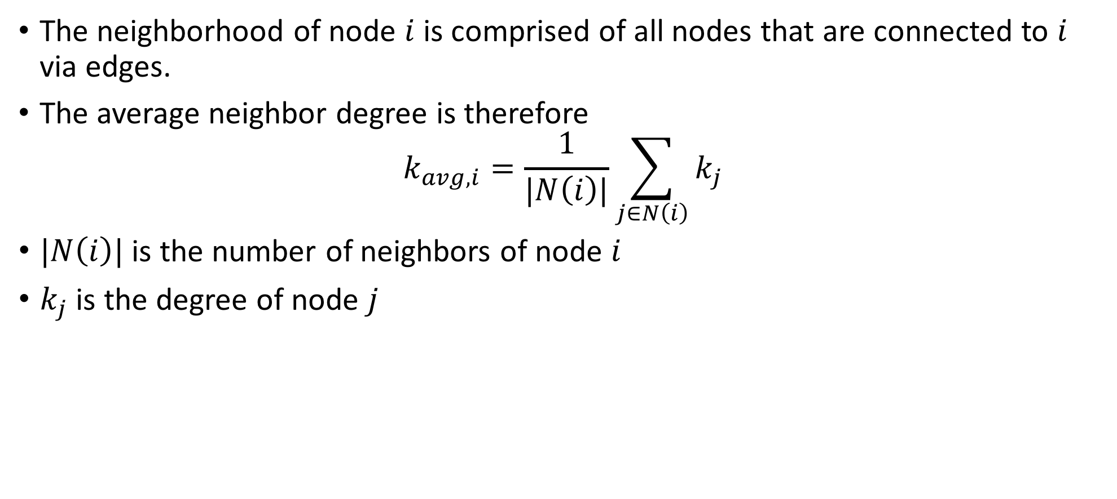
Neighborhood Degree
The neighborhood of node $i$ is comprised of all nodes that are connected to $i$ via edges.
The average neighbor degree is therefore
$$k_{avg,i}=\frac{1}{|N\left(i\right)|}\sum_{j∈N\left(i\right)}{k_{j}}$$
$|N\left(i\right)|$ is the number of neighbors of node $i$
$k_{j}$ is the degree of node $j$

Slide 51
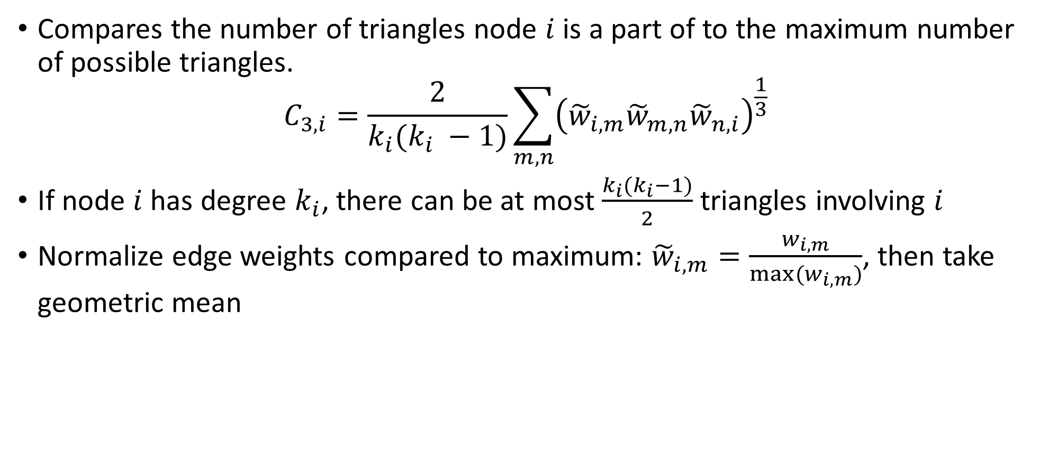
Triangle Clustering
Compares the number of triangles node $i$ is a part of to the maximum number of possible triangles.
$$C_{3,i}=\frac{2}{k_{i}(k_{i} −1)}\sum_{m,n}{{\left({\tilde{w}}_{i,m}{\tilde{w}}_{m,n}{\tilde{w}}_{n,i}\right)}^{\frac{1}{3} }}$$
If node $i$ has degree $k_{i}$, there can be at most $\frac{k_{i}(k_{i}−1)}{2}$ triangles involving $i$
Normalize edge weights compared to maximum: ${\tilde{w}}_{i,m}=\frac{w_{i,m}}{max⁡(w_{i,m})}$, then take geometric mean

Slide 52
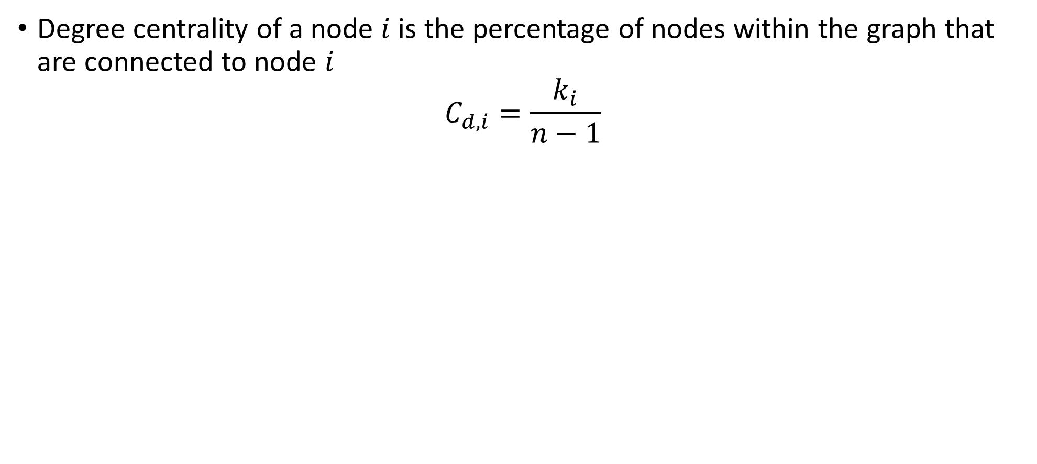
Degree Centrality
Degree centrality of a node $i$ is the percentage of nodes within the graph that are connected to node $i$
$$C_{d,i}=\frac{k_{i}}{n−1}$$

Slide 53
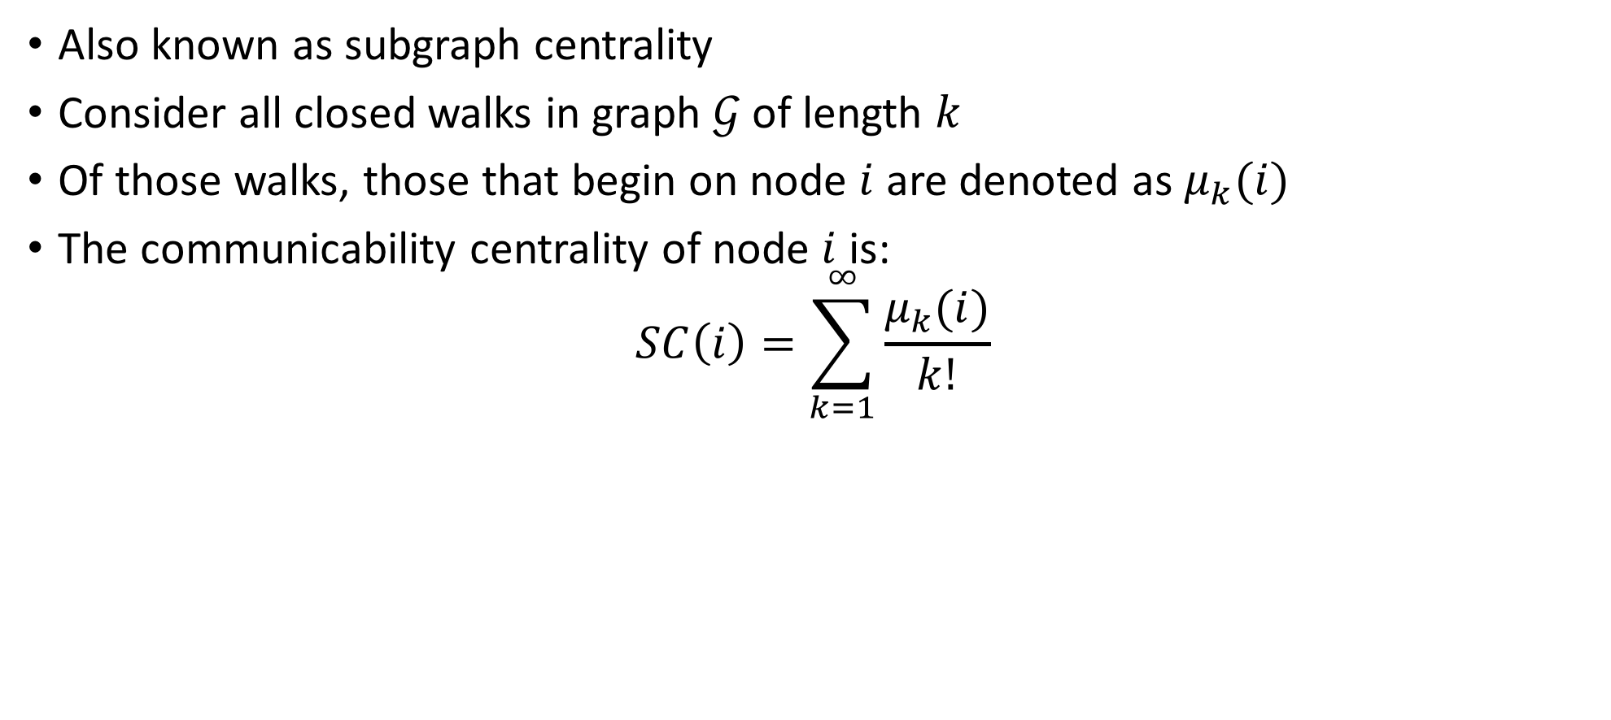
Communicability Centrality
Also known as subgraph centrality
Consider all closed walks in graph $𝒢$ of length $k$
Of those walks, those that begin on node $i$ are denoted as $μ_{k}(i)$
The communicability centrality of node $i$ is:
$$SC\left(i\right)=\sum_{k=1}^{∞}{\frac{μ_{k}(i)}{k!}}$$

Slide 54
Some Worst Performing Features
New | Feature | Type | Information Gain
 | Total Received Encrypted | Traffic | 0
 | Unique Addresses Sent Signed | Traffic | 0
 | Inter-Hume Received | Traffic | 0
 | Unique Addresses Received | Traffic | 0
 | Total Sent Encrypted | Traffic | 0
 | Number of Cliques (full graph) | Social | 0
 | Inter-VT Sent | Traffic | 0
 | Betweenness Centrality (partial graph) | Social | 0
 | Clustering (partial graph) | Social | 0
 | Average Neighbor Degree (full graph) | Social | 0
 | Average Subject Characters Received | Traffic | 0

